Slide 1


Object Oriented Thought Process

Slide 2
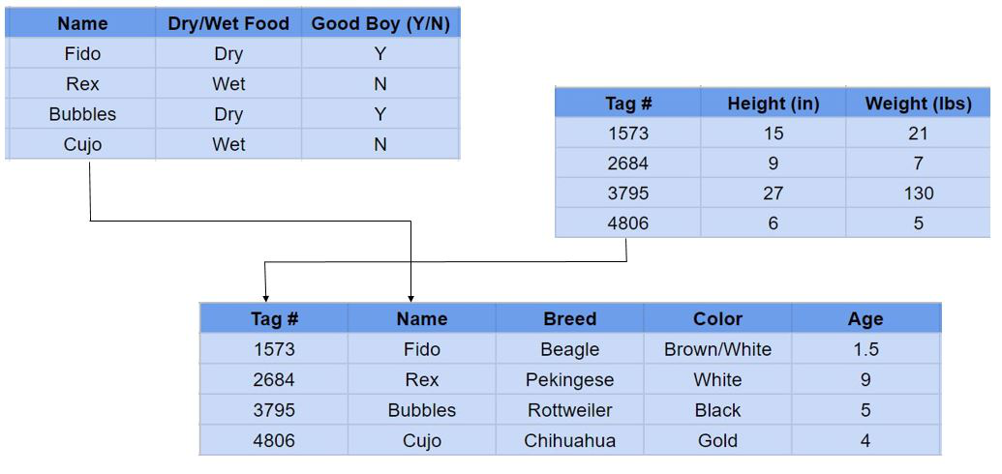

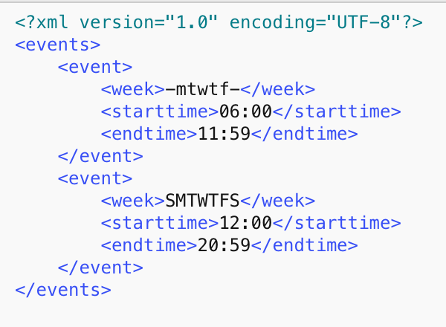
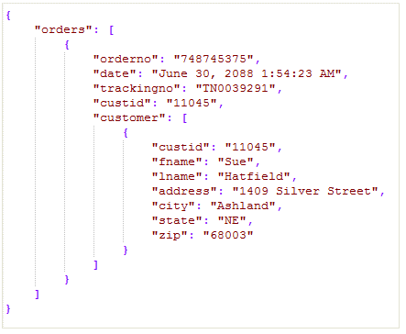
Why Object Orientation ???
Relational Data
Types Of Data
XML
JSON

Slide 3
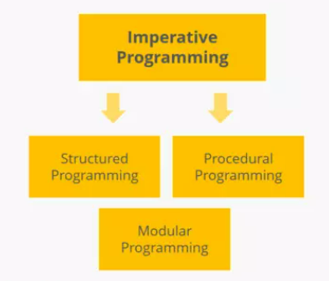
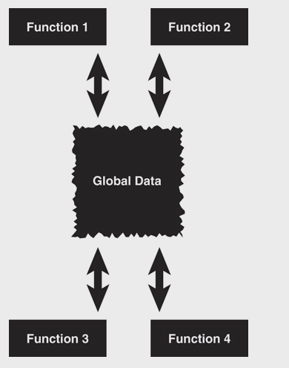
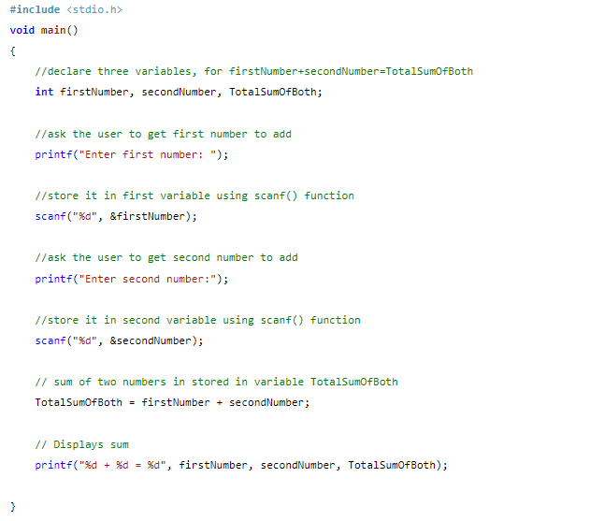
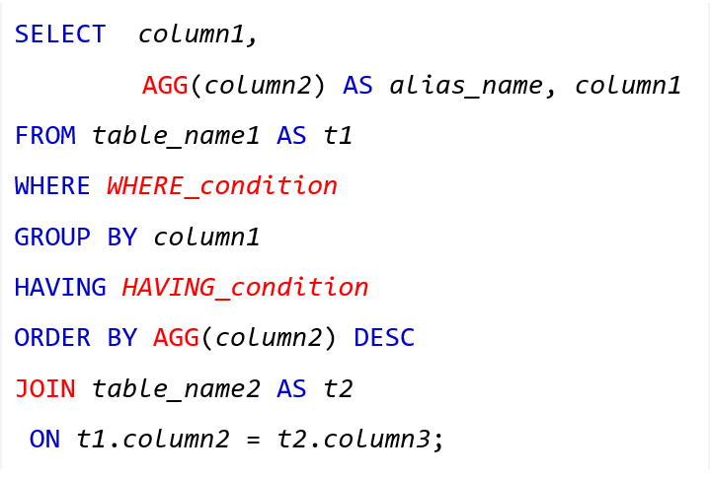
Imperative Programming

Slide 4
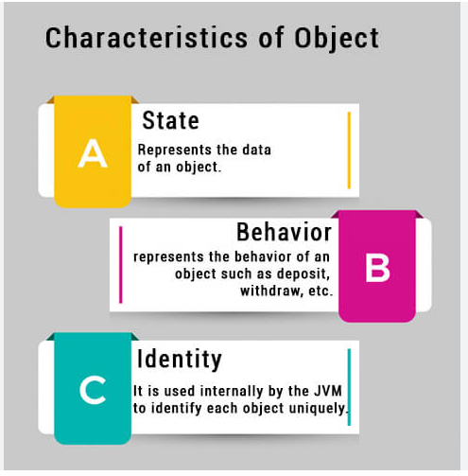
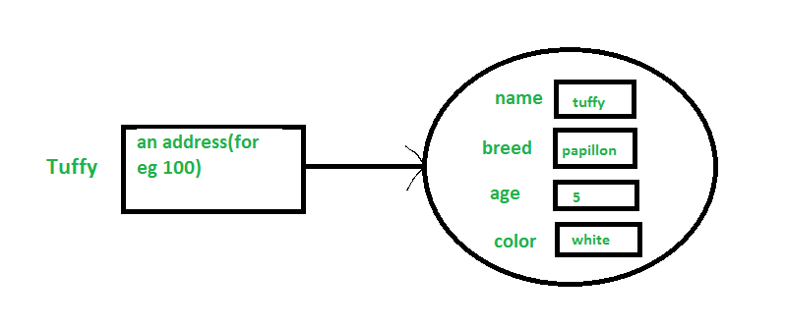
What's An Object
Dog Object

Slide 5
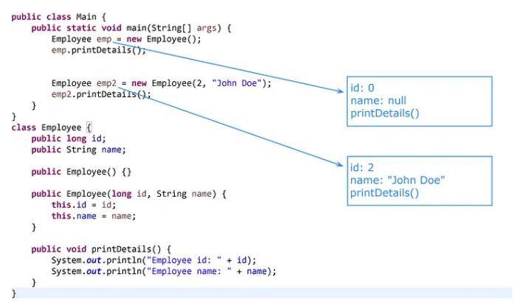
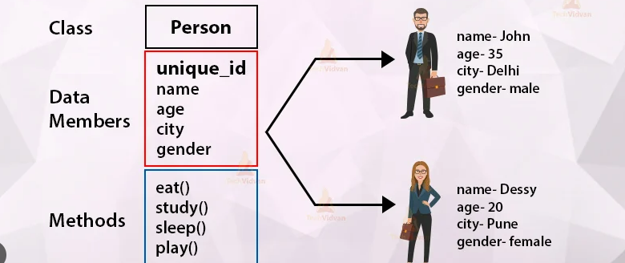
What's a Class ???

Slide 6
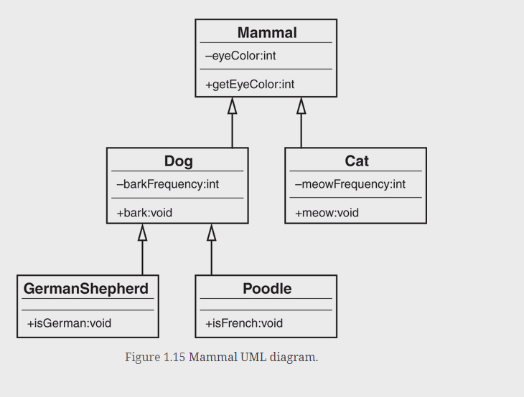
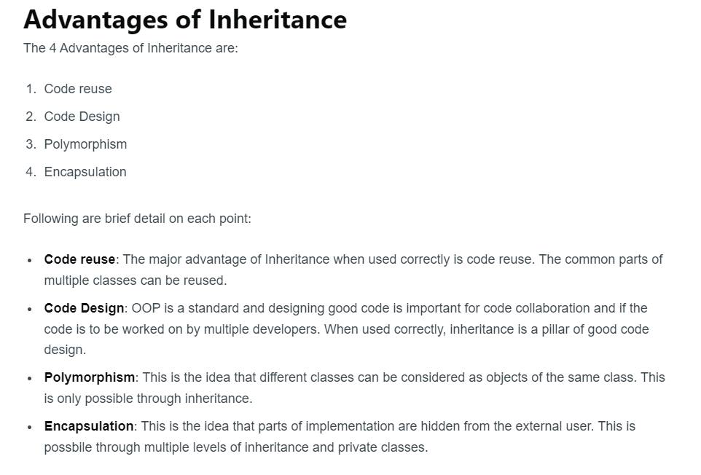
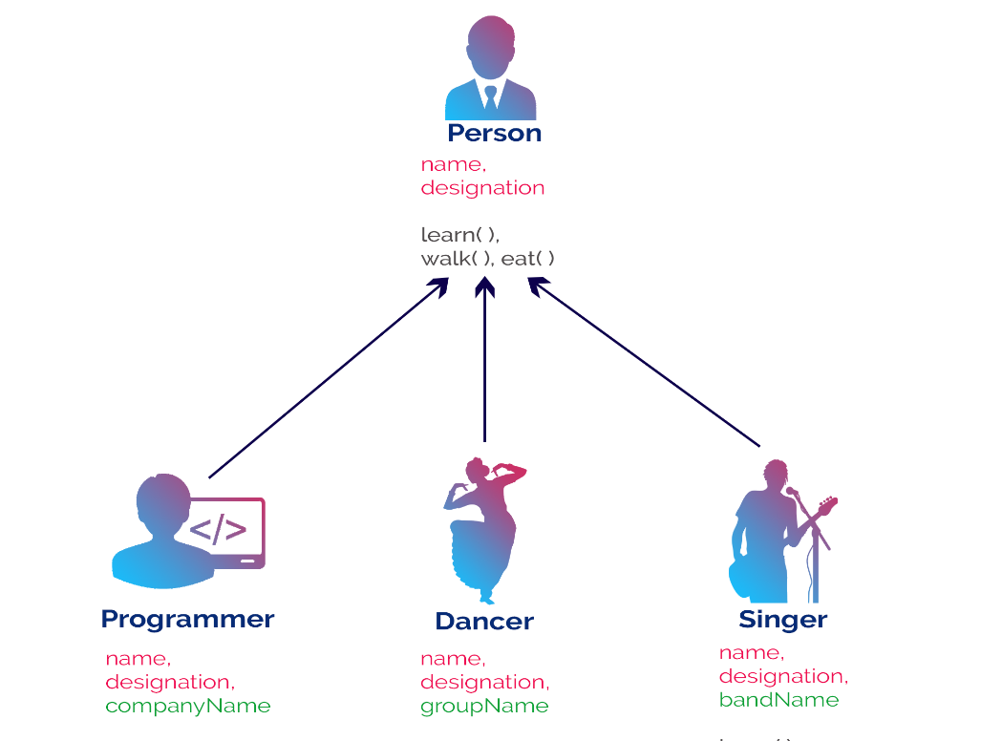
Abstraction & Inheritance

Slide 7
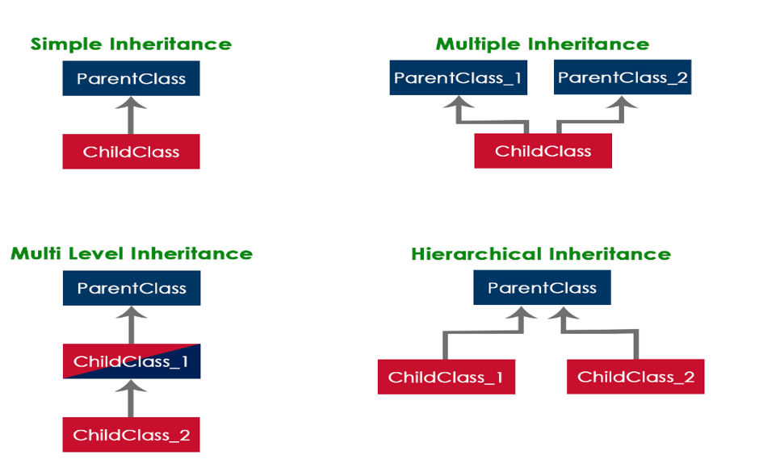
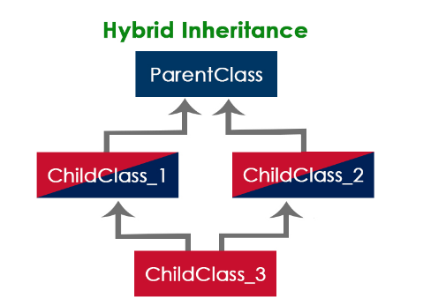
Inheritance Types

Slide 8
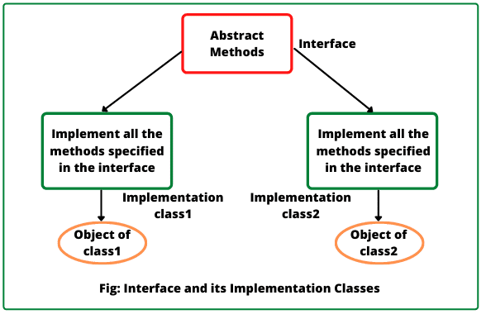

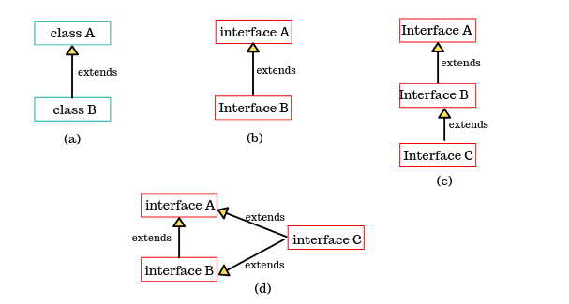
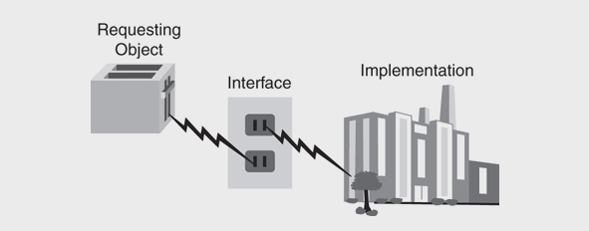
An Interface

Slide 9
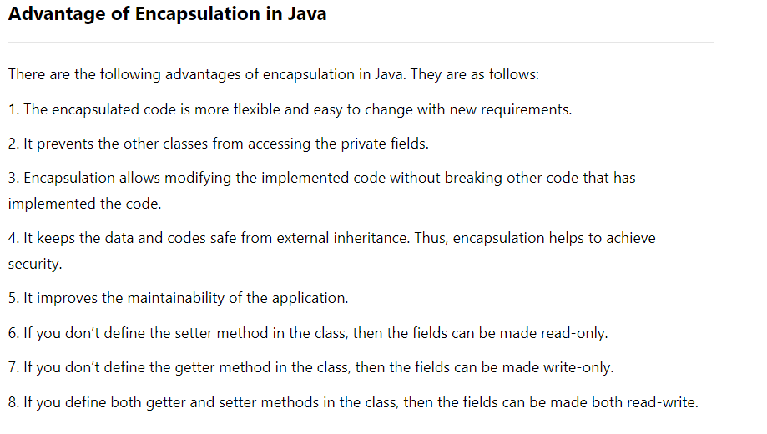
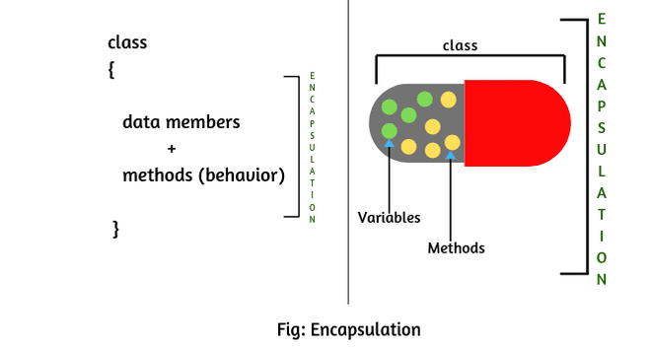
Object Encapsulation

Slide 10
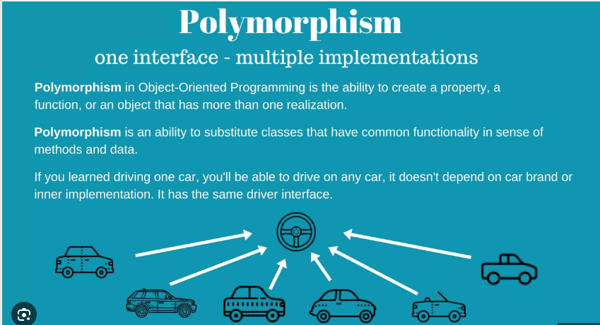
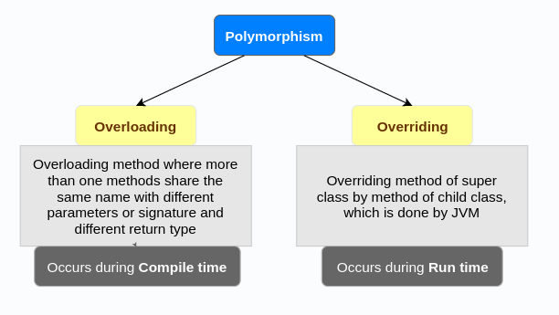
Polymorphism

Slide 11
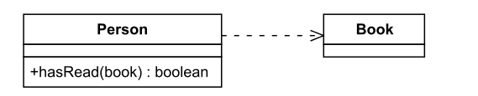
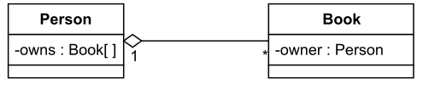
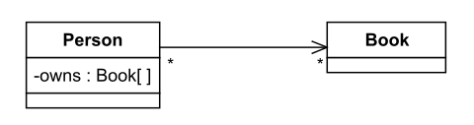
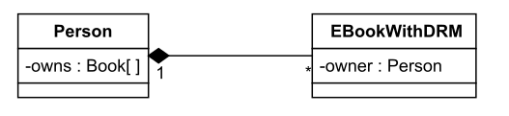
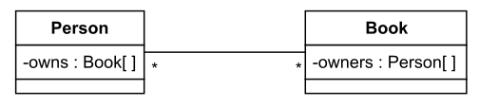
Class Diagram
Dependency
Aggregation
Unidirectional Association
Compositions
Bidirectional Association

Slide 12
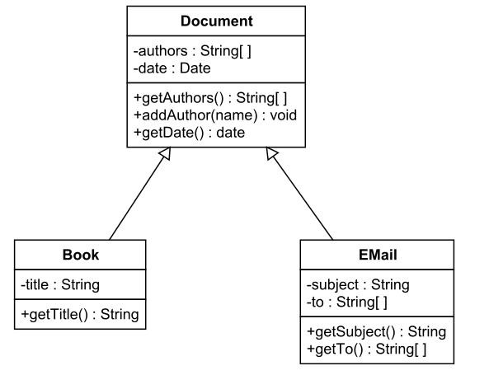
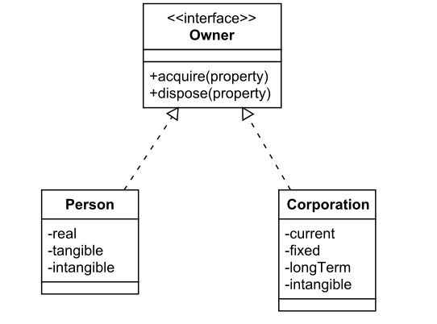
Inheritance Relationship
Generalization
Realization

Slide 13
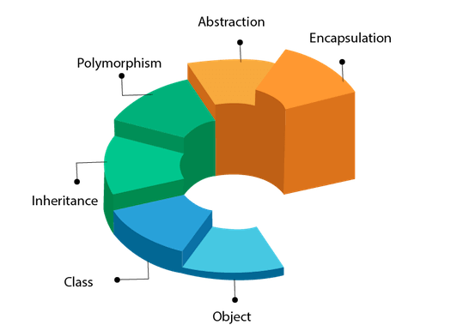
Think In-terms of Object
- Workshop
Design a class level diagram for,
RVCE
Car

Slide 14
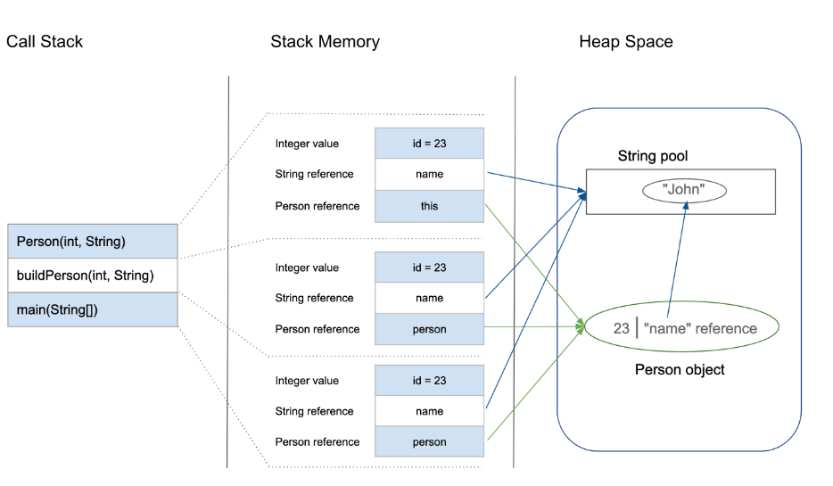
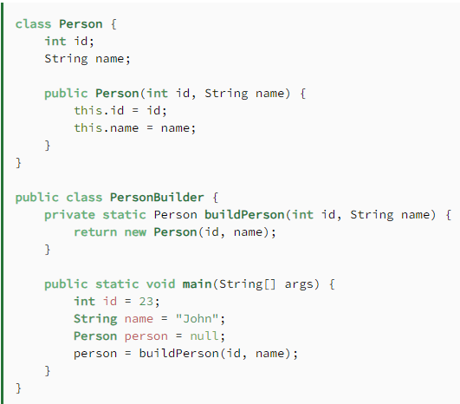
Java Memory : Stack & Heap

Slide 15
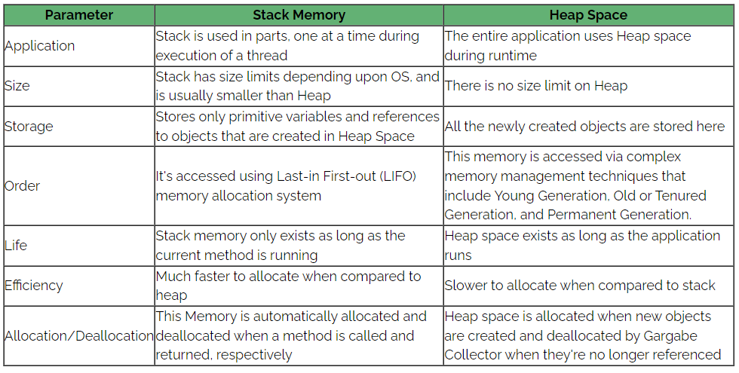
Java Memory : Stack & Heap

Slide 16

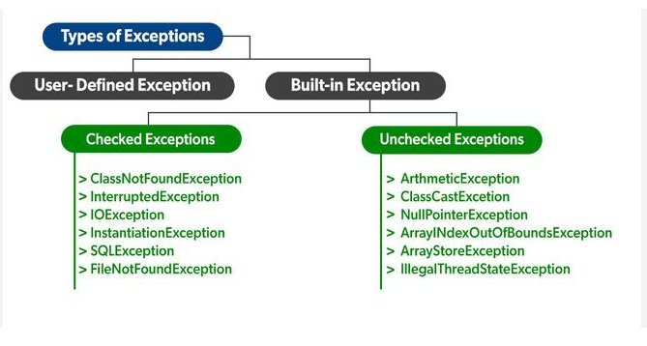
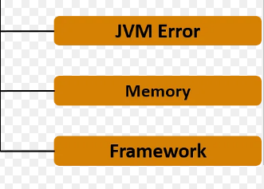
More Object-Oriented Concepts
Error Handling
Constructors
- Default Constructor
- Overloading Constructors
Super ()

Slide 17
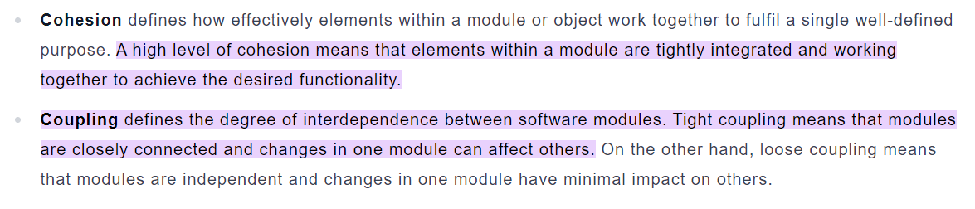
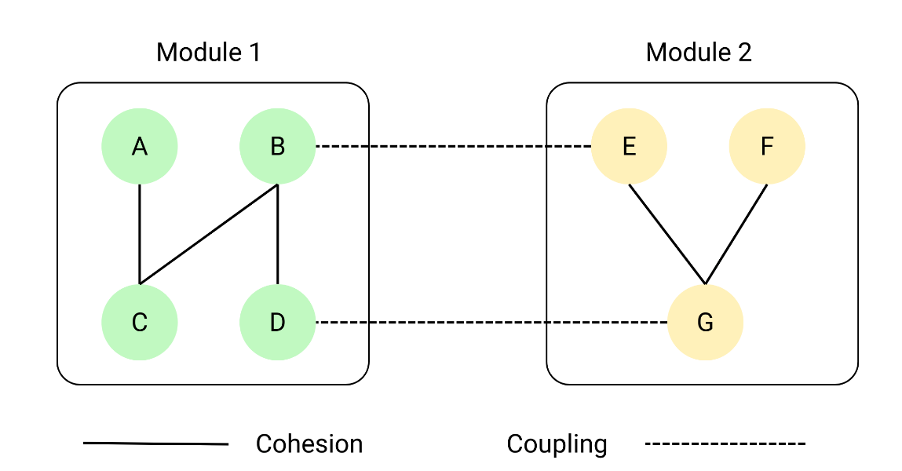
Cohesion & Coupling in OOD

Slide 18
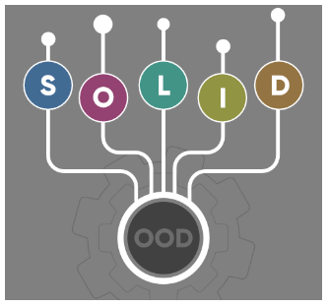
OOD- SOLID Principles
In software development, Object-Oriented Design plays a crucial role when it comes to writing flexible, scalable, maintainable, and reusable code.
There are so many benefits of using OOD, but every developer should also have the knowledge of the SOLID principle for good object-oriented design in programming.
The SOLID principle was introduced by Robert C. Martin, also known as Uncle Bob and it is a coding standard in programming.
This principle is an acronym of the five principles which is given below.
Single Responsibility Principle (SRP)
Open/Closed Principle
Liskov’s Substitution Principle (LSP)
Interface Segregation Principle (ISP)
Dependency Inversion Principle (DIP)

Slide 19
OOD- SOLID Principles
Single Responsibility Principle
This principle states that “a class should have only one reason to change”
which means every class should have a single responsibility or single job or single purpose.
Advantages
Frequency and Effects of Changes
Easier to Understand
Use cases :
Design the classes using Single Responsibility Principle ,
Pizza Delivery
Bank Account
A Simple Question to Validate Your Design “What’s your responsibility”

Slide 20
OOD- SOLID Principles
Open and Closed Principle
This principle states that “software entities (classes, modules, functions, etc.) should be open for extension,
but closed for modification”
“A class is closed, since it may be compiled, stored in a library, baselined, and used by client classes.
But it is also open, since any new class may use it as parent, adding new features. When a descendant class is defined,
there is no need to change the original or to disturb its clients.”
Use cases :
Design the classes using Open and Closed Principle,
Cuboid
Bank Account

Slide 21
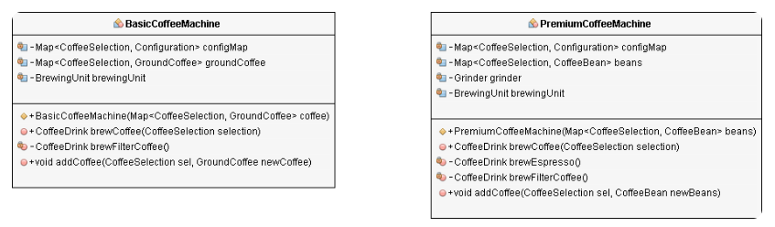
OOD- SOLID Principles
Liskov Substitution Principle
The principle defines that objects of a superclass shall be replaceable with objects of its subclasses without breaking the
application. That requires the objects of your subclasses to behave in the same way as the objects of your superclass.

Slide 22
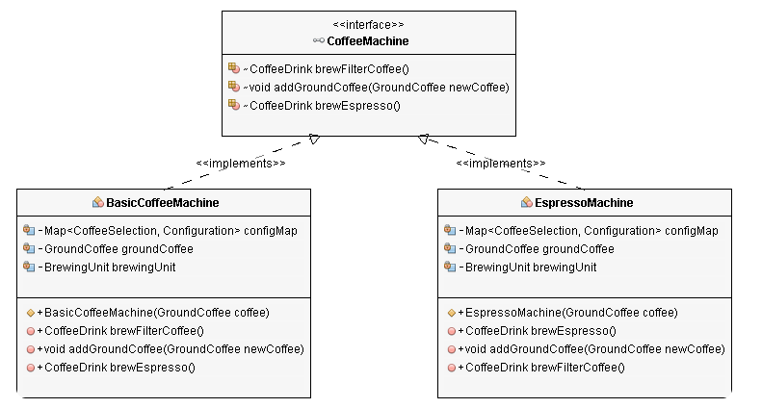
OOD- SOLID Principles
Liskov Substitution Principle

Slide 23
OOD- SOLID Principles
The Interface Segregation Principle
The Interface Segregation Principle was defined by Robert C. Martin while consulting for Xerox to help them build
the software for their new printer systems.
He defined it as:
“Clients should not be forced to depend upon interfaces that they do not use.”

Slide 24
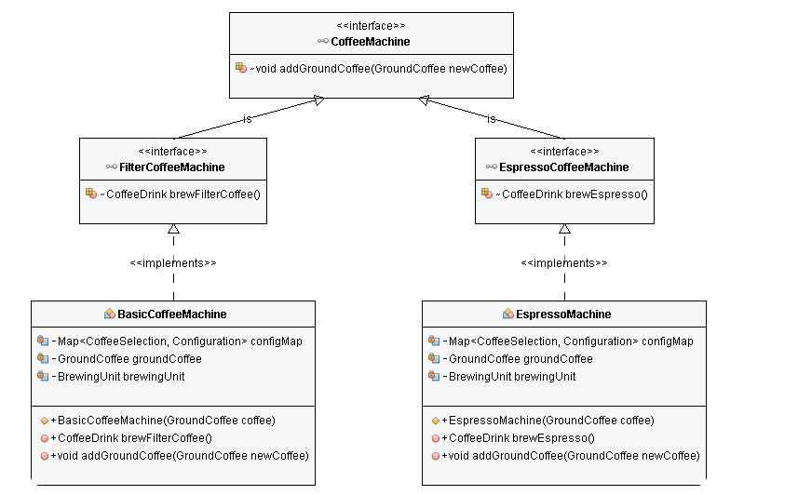
OOD- SOLID Principles
The Interface Segregation Principle

Slide 25
OOD- SOLID Principles
Dependency Inversion
The Interface Segregation Principle was defined by Robert C. Martin while consulting for Xerox to help them build
the software for their new printer systems.
Based on this idea, Robert C. Martin’s definition of the Dependency Inversion Principle consists of two parts:
High-level modules should not depend on low-level modules. Both should depend on abstractions.
Abstractions should not depend on details. Details should depend on abstractions.

Slide 26
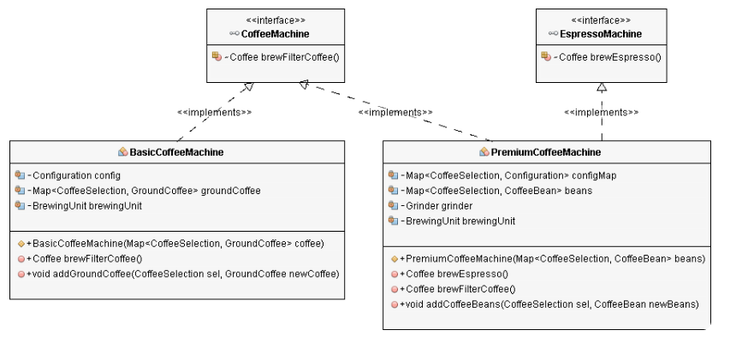
OOD- SOLID Principles
Dependency Inversion

Slide 27
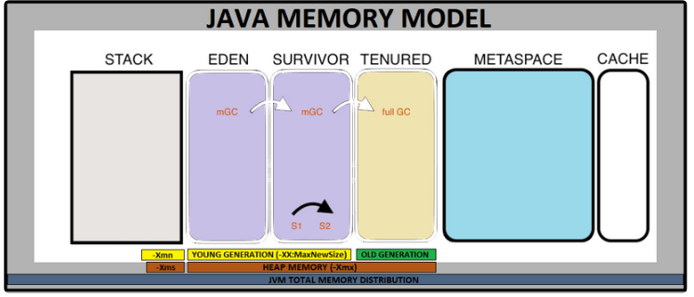
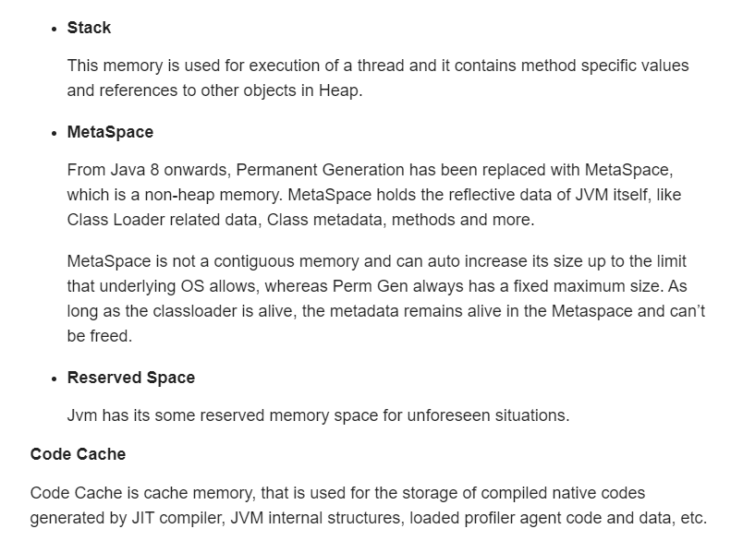

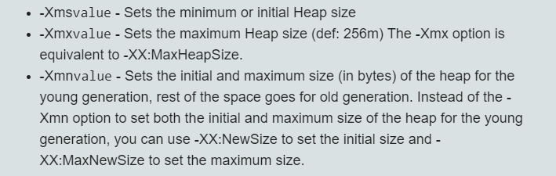
Java Memory

Slide 28
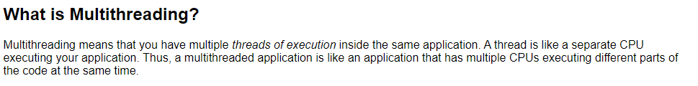
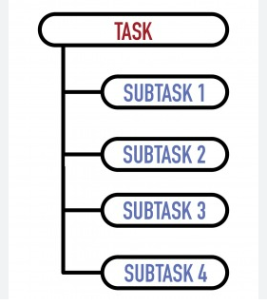
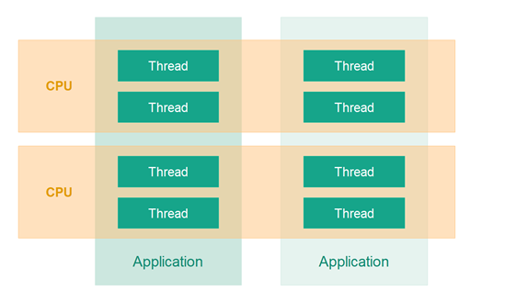
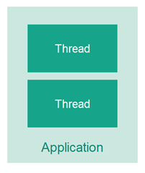
Java Concurrency
Parallelism
Concurrency
CPU

Slide 29




Java Concurrency

Slide 30

Java Concurrency
Thread States

Slide 31

Problems in Java Concurrency
Dead Lock

Slide 32


Problems in Java Concurrency
Starvation
Live Lock

Slide 33



Java Concurrency
Producer Consumer Problem

Slide 34


Java Concurrency
Blocking Thread
Non-Blocking Thread

Slide 35




Slide 36


Creational - Factory Pattern

Slide 37


Creational - Factory Pattern

Slide 38

Creational - Factory Pattern

Slide 39



Creational - Abstract Factory

Slide 40

Creational - Abstract Factory

Slide 41


Creational - Abstract Factory

Slide 42

Creational - Abstract Factory

Slide 43

Creational – Singleton Pattern

Slide 44



Structural - Builder Pattern

Slide 45



Structural - Adapter Pattern

Slide 46



Strcutural - Bridge Pattern

Slide 47


Structural - Decorator Pattern

Slide 48




Slide 49



Understanding Maven

Slide 50


Understanding Maven

